Slide 1
Graph Data and Analysis
By: Raghav Borikar

Slide 2
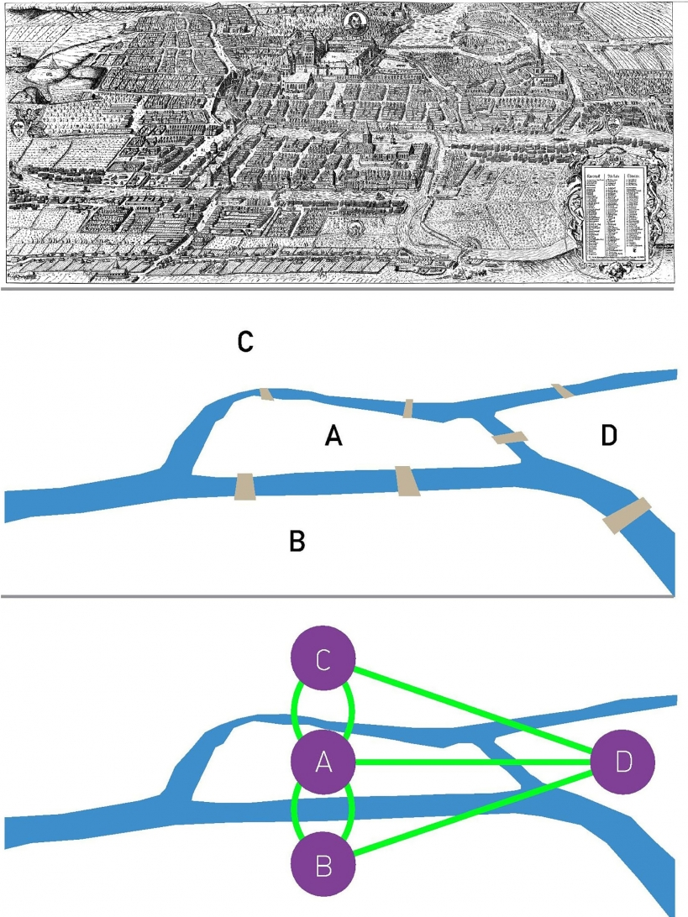
Agenda
Introduction
Types of Graphs
Properties of Graphs
Centrality Measures
Assortativity/Dis.
Community Detection
Some Real-World Examples

Slide 3
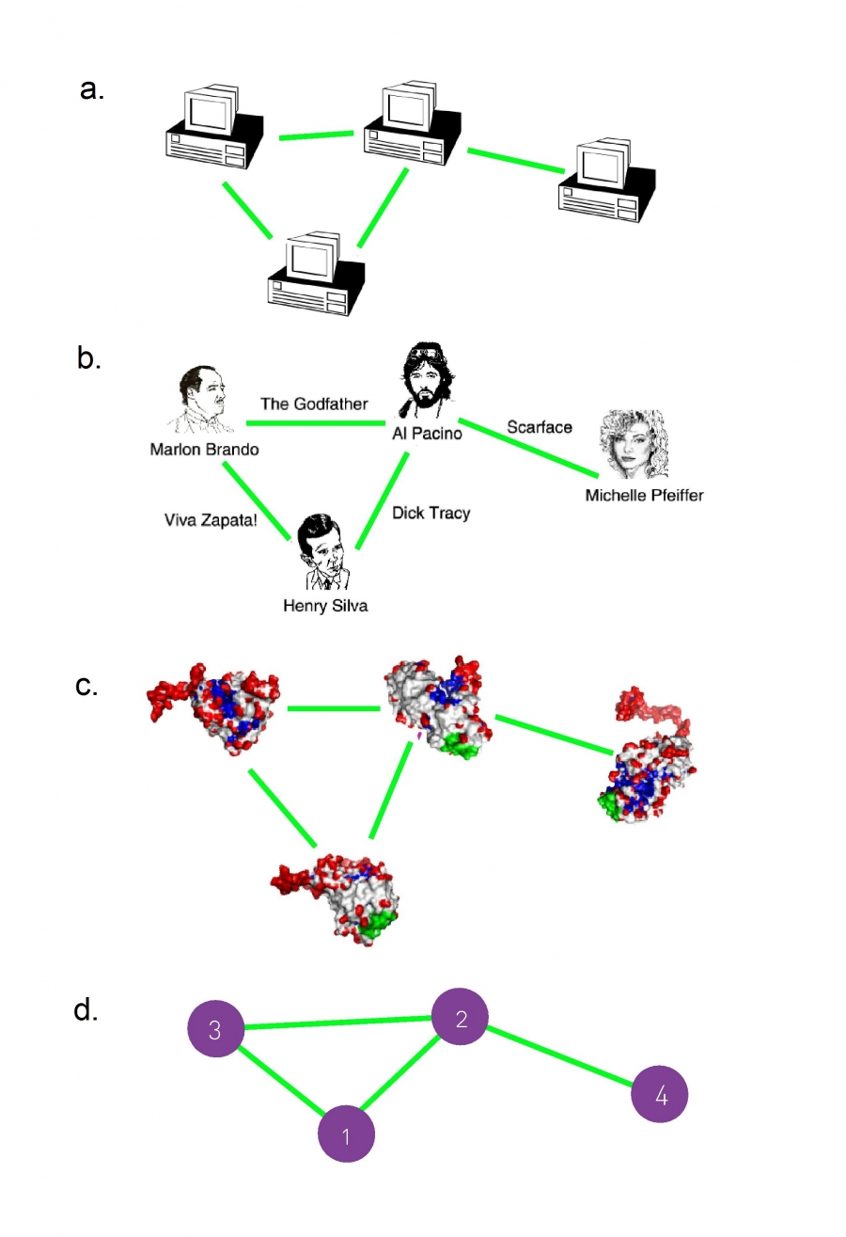
Introduction
🔍 What Are Graphs?
Graphs are mathematical structures used to model pairwise relationships between objects.
Represented as nodes (also called vertices) and edges (connections between nodes)

Slide 4
Introduction
💡 Why Study Graphs?
Real-world data is often relational.
Graphs capture both structure and dynamics of systems
Enables deep insights through:
Centrality and influence
Clustering and community detection
Network resilience and vulnerability

Slide 5
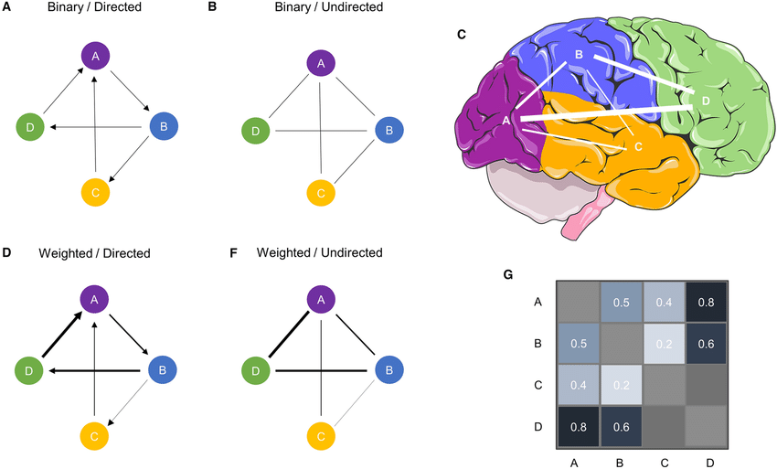
Types of Graphs
Graphs can be Classified based on various criteria:
Edge Attributes
Directionality
Connectedness & Connectivity
Groupings
Multi-Edge Support etc.

Slide 6
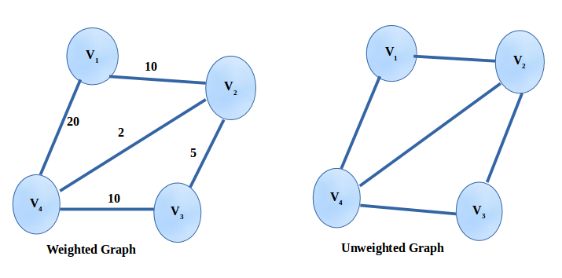
Types of Graphs
Weighted Graph
Each edge has a numeric value (weight) representing cost, strength, distance, frequency, etc.
Example: Roads (distance), Co-authorship (number of papers), E-commerce similarity.
Unweighted Graph
All edges have equal importance.
Common in basic social or friendship graphs.

Slide 7
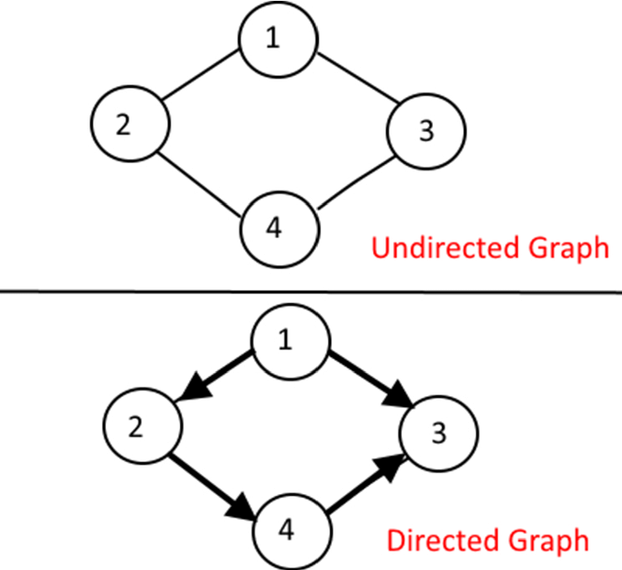
Types of Graphs
Undirected Graph
Edges have no direction.
Example: Facebook friendships.
Directed Graph (Digraph)
Edges have a defined source and target.
Example: Twitter follower graph, citation networks

Slide 8
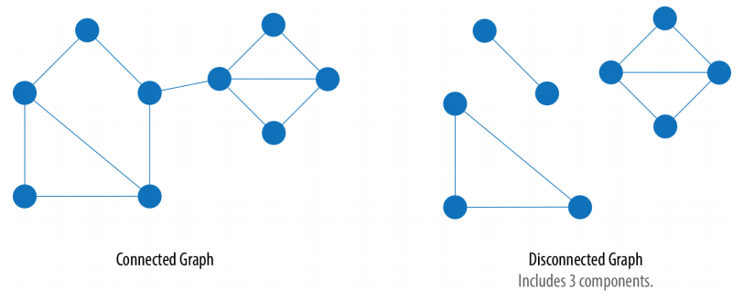
Types of Graphs
Connected Graph
There exists a path between every pair of nodes.
Ensures full information flow or reachability.
Disconnected Graph
Contains isolated components or individual nodes.
Common in fragmented social or communication networks.

Slide 9
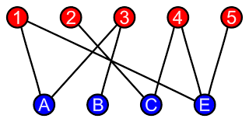
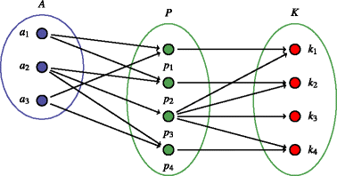
Types of Graphs
Bipartite Graph
Two disjoint node sets (U, V) with edges only between them.
Example: Users ↔ Movies, Students ↔ Courses.
k-Partite Graphs
Generalization to more than two groups.
Example: Customer ↔ Merchant ↔ Product

Slide 10
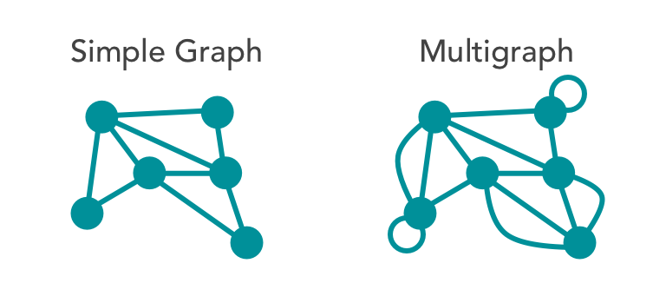
Types of Graphs
Simple Graph
At most one edge between any pair of nodes; no self-loops.
Multigraph
Multiple edges allowed between the same nodes.
Example: Multiple flights between two cities.

Slide 11
Properties of Graphs
🔹 Overview
Graph properties describe the structure and behavior of graphs. These help in:
Understanding network shape
Analyzing connectivity and robustness
Guiding algorithm design (e.g., traversal, clustering)

Slide 12
Properties of Graphs
🔹 Degree
Degree (Undirected): Number of connections a node has.
In-degree / Out-degree (Directed): Incoming and outgoing edges.
🔹 Degree Distribution
Shows how degrees are spread across all nodes.
Useful to identify whether the network is homogeneous or has hubs.
📊 Visual: Bar chart or histogram of degree frequency.

Slide 13
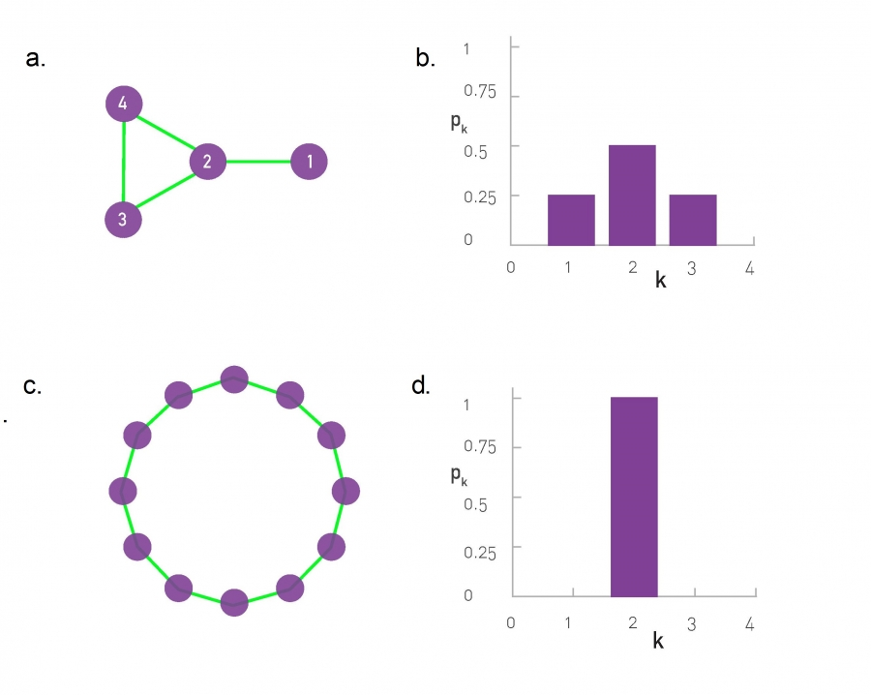
Properties of Graphs
An example of degree distribution plots (normalized). Taken from Albert Laszlo Barabasi’s book

Slide 14
Properties of Graphs
🔹 Shortest Path
The smallest number of edges between two nodes.
🔹 Diameter
Longest shortest path in the graph.
🔹 Average Path Length
Average of shortest paths between all pairs of nodes.
📌 Why It Matters: Measures efficiency of information spread.

Slide 15

Properties of Graphs
🔹 Local Clustering
Measures how connected a node's neighbors are to each other.
🔹 Global Clustering
Average local clustering over all nodes.
📌 Interpretation: Higher clustering = tightly-knit communities, typical in social networks.

Slide 16
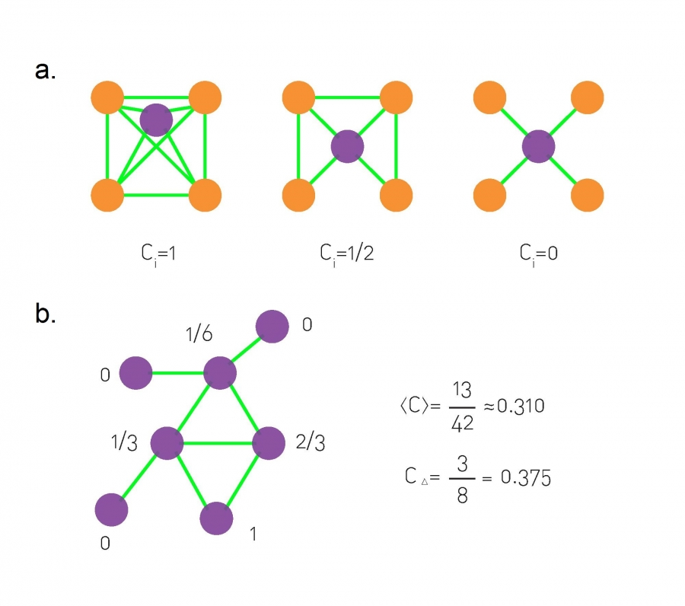
Properties of Graphs
Another Example from the book of Albert Laszlo Barabasi

Slide 17

Properties of Graphs
🔹 Graph Density
Ratio of actual edges to the maximum possible edges:
🔹 Interpretation
Dense graph: Many connections, close to complete.
Sparse graph: Few connections, most real-world networks.
📌 Why Important: Affects algorithm performance and structural modelling.
.

Slide 18
Centrality Measures
🔹 What is Centrality?
Centrality quantifies the importance, influence, or position of nodes in a network.
Used in:
Identifying influential users in social networks
Finding bottlenecks in transportation or communication systems
Ranking nodes in web, citation, and biological networks

Slide 19
Centrality Measures
🔹 Types of Centrality Measures
Degree Centrality
Closeness Centrality
Betweenness Centrality
Eigenvector Centrality
PageRank
📌 Note: No single centrality is best for all problems — each captures a different aspect of "importance."

Slide 20

Centrality Measures
🔹 Degree Centrality
Measures how many edges a node has.
🔹 In/Out Degree
For directed graphs:
In-degree: Nodes that point to vertex
Out-degree: Nodes pointed to by vertex
🔹 Use Cases
Detect highly connected individuals
Hubs in infrastructure or fraud networks.
🔹 Formula (Normalized)

Slide 21
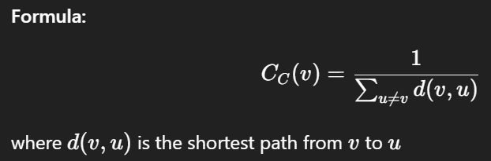
Centrality Measures
🔹 Closeness Centrality
Measures how close a node is to all other nodes.
🔹 Interpretation
Nodes with low average distance to others have high closeness
Good for fast spread of information or navigation
🔹 Use Cases
Rumour spreaders, command centres, optimized logistics
🔹 Formula

Slide 22
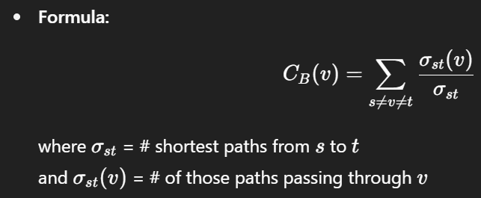
Centrality Measures
🔹 Betweenness Centrality
Measures how often a node appears on shortest paths between other nodes.
🔹 Interpretation
Measures control, brokerage, or bottlenecks in flow
🔹 Use Cases
Network mediators, bridges, cut-points in communication
🔹 Formula

Slide 23
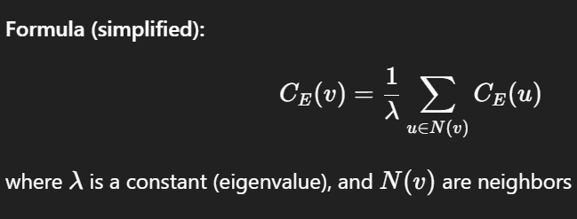
Centrality Measures
🔹 Eigen Vector Centrality
A node is important if it is connected to other important nodes.
Recursive measure.
🔹 Use Cases
Influencers in social networks
Later derived into PageRank
📌 Note: Captures quality of connections, not just quantity
🔹 Formula

Slide 24
Centrality Measures
🔹 PageRank
Originally developed by Google to rank web pages.
Measures how likely someone is to land on a node by random surfing.
Balances link popularity and random jumps.
🔹 Key Ideas:
More important if many important nodes point to it.
Robust to spam and better for directed graphs.
🔹 Use Cases:
Ranking websites, influencers, scientific papers, citation networks
📌 Tip: Useful when direction of influence matters

Slide 25
Assortativity
🔹 What is Assortativity?
Assortativity measures the tendency of nodes to connect to other nodes that are similar in some way.
Similarity can be based on:
Node degree (most common)
Attributes (age, gender, role, etc.)
📌 Why Important? Reveals underlying organization in real-world networks (e.g., social stratification, heterogeneity)

Slide 26
Assortativity
🔹 Degree Assortativity Coefficient
Measures the correlation between the degrees of connected nodes.
🔹 Interpretation:
r>0: Assortative — similar-degree nodes connect (e.g., social networks)
r<0: Disassortative — dissimilar-degree nodes connect (e.g., biological/technological networks)
r=0: No correlation — random wiring

Slide 27
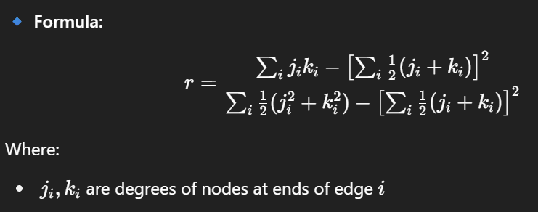
Assortativity

Slide 28
Assortativity
🔹 Real World Examples
🔹 Assortative Graph
High-degree nodes connect to other high-degree nodes
Example: Friend groups in social networks, Social networks (Facebook, academic collaborations), People of similar popularity/wealth tend to connect
🔹 Disassortative Graph
High-degree nodes connect to low-degree nodes
Example: Hub-and-spoke structures (e.g., routers, star topologies), Biological networks (protein interaction), Internet at the router level

Slide 29
Assortativity
🔹 Some Features
🔹 Assortative Networks
Leads to community formation and echo chambers
🔹 Disassortative Networks
, Hubs connect to many peripherals — efficient but vulnerable
📌 Impact:
Assortative networks: Robust against random failures
Disassortative networks: Efficient but prone to targeted attacks on hubs

Slide 30
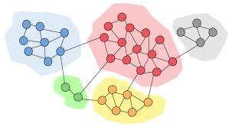
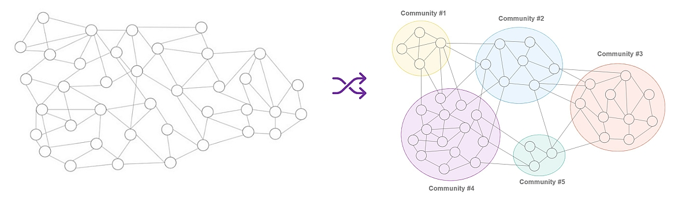
Community Detection

Slide 31
Community Detection
🔹 What Is Community Detection?
Process of identifying clusters that are more densely connected internally than with the rest of the graph. Also known as: Graph clustering, modular decomposition, network partitioning
🔹 Why It Matters
Understand network structure, Discover functional units in biological, social, citation networks, Improve recommendation systems, marketing, fraud detection
📌 Core idea: Communities ≠ explicit labels — they are latent structures discovered from connectivity.

Slide 32
Community Detection
🔹Types of Clusters
🔹 Based on Structure
Disjoint Communities: Each node belongs to only one community
Overlapping Communities: Nodes can belong to multiple groups (e.g., people in multiple friend circles)
🔹 Based on Method
Hard Clustering: Partitions nodes (e.g., Louvain, Girvan–Newman)
Soft Clustering: Assigns probabilities of membership (e.g., stochastic block models)

Slide 33
Community Detection
🔹 What Is Modularity?
A score that quantifies the strength of division into communities.
Compares actual edges within communities to expected edges in a random graph.
📌 Interpretation:
Q∈[−1,1]
Higher Q = stronger community structure
Typical real-world graphs: Q>0.3 indicates strong modularity

Slide 34
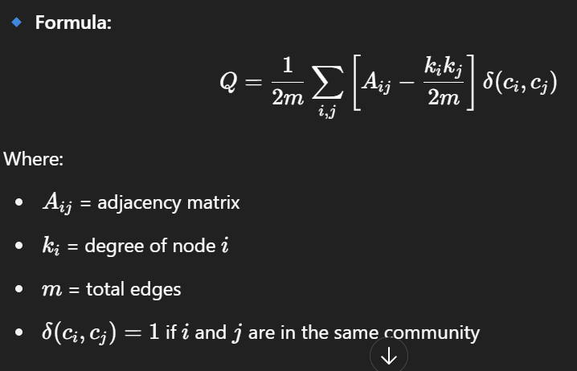
Community Detection

Slide 35
Community Detection
Applications of Community Detection
🔹 Social Networks: Discover friend groups, cliques, influencers
🔹 E-Commerce / Recommender Systems: Group users/products for collaborative filtering
🔹 Citation/Co-authorship Graphs: Detect research fields, emerging topics
🔹 Biological Networks: Functional gene/protein modules
📌 Bonus Insight: Overlapping communities can uncover hidden roles or multi-group participation

Slide 36
What we Covered
Types of Graphs
Properties of Graphs
Centrality Measures
Directed vs. Undirected, Weighted vs. Unweighted
Simple vs. Multigraphs, Bipartite, Dynamic, Acyclic
Degree & Distribution, Clustering Coefficient, Path Lengths
Connectivity, Density, Cycles, Components
Degree, Closeness, Betweenness, Eigenvector, PageRank.
Each highlights different aspects of influence & reach

Slide 37
What we Covered
Assortativity
Community Detection
Measures homophily vs heterophily in connections.
Important for understanding structural tendencies (e.g., hubs vs. communities)
Evaluated via modularity.
Applied in social, citation, bio, and recommender networks

Slide 38

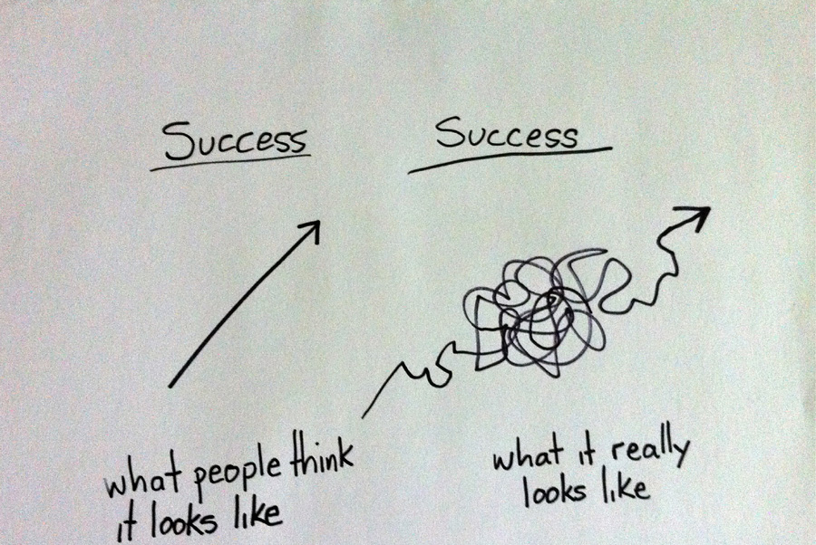
Key Takeaways
Graphs capture relational structure of real-world systems
Different metrics and models reveal unique insights
Practical tools like NetworkX and Gephi are essential for exploration

Slide 39

Thank you
📌 "Understanding structure is the first step to understanding behavior."
Raghav Borikar
raghavbori@iitbhilai.ac.in

